Slide 1

Project Status Report

Slide 2

ABSTRACT

Slide 3
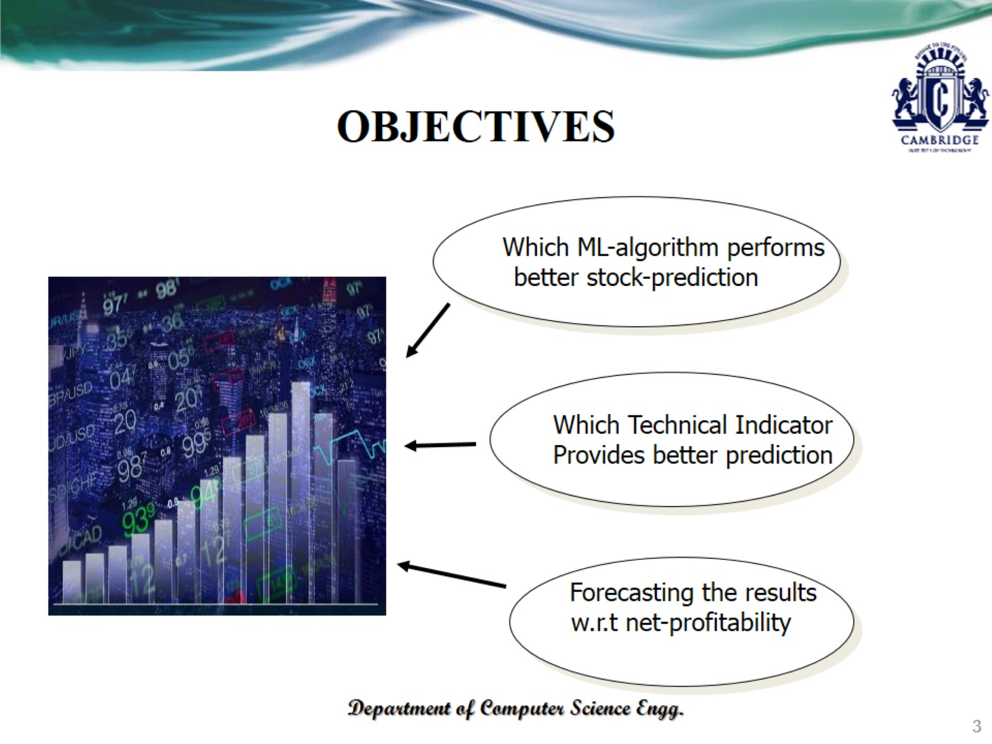
OBJECTIVES

Slide 4

INTRODUCTION

Slide 5
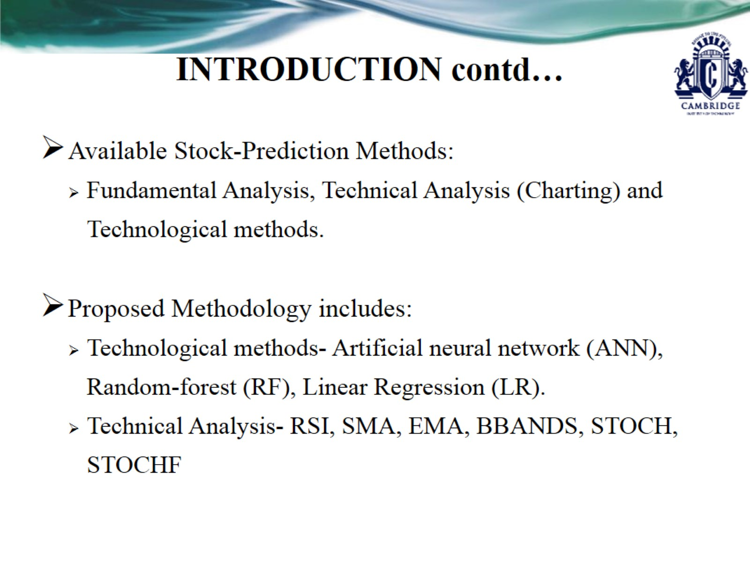
INTRODUCTION contd…

Slide 6
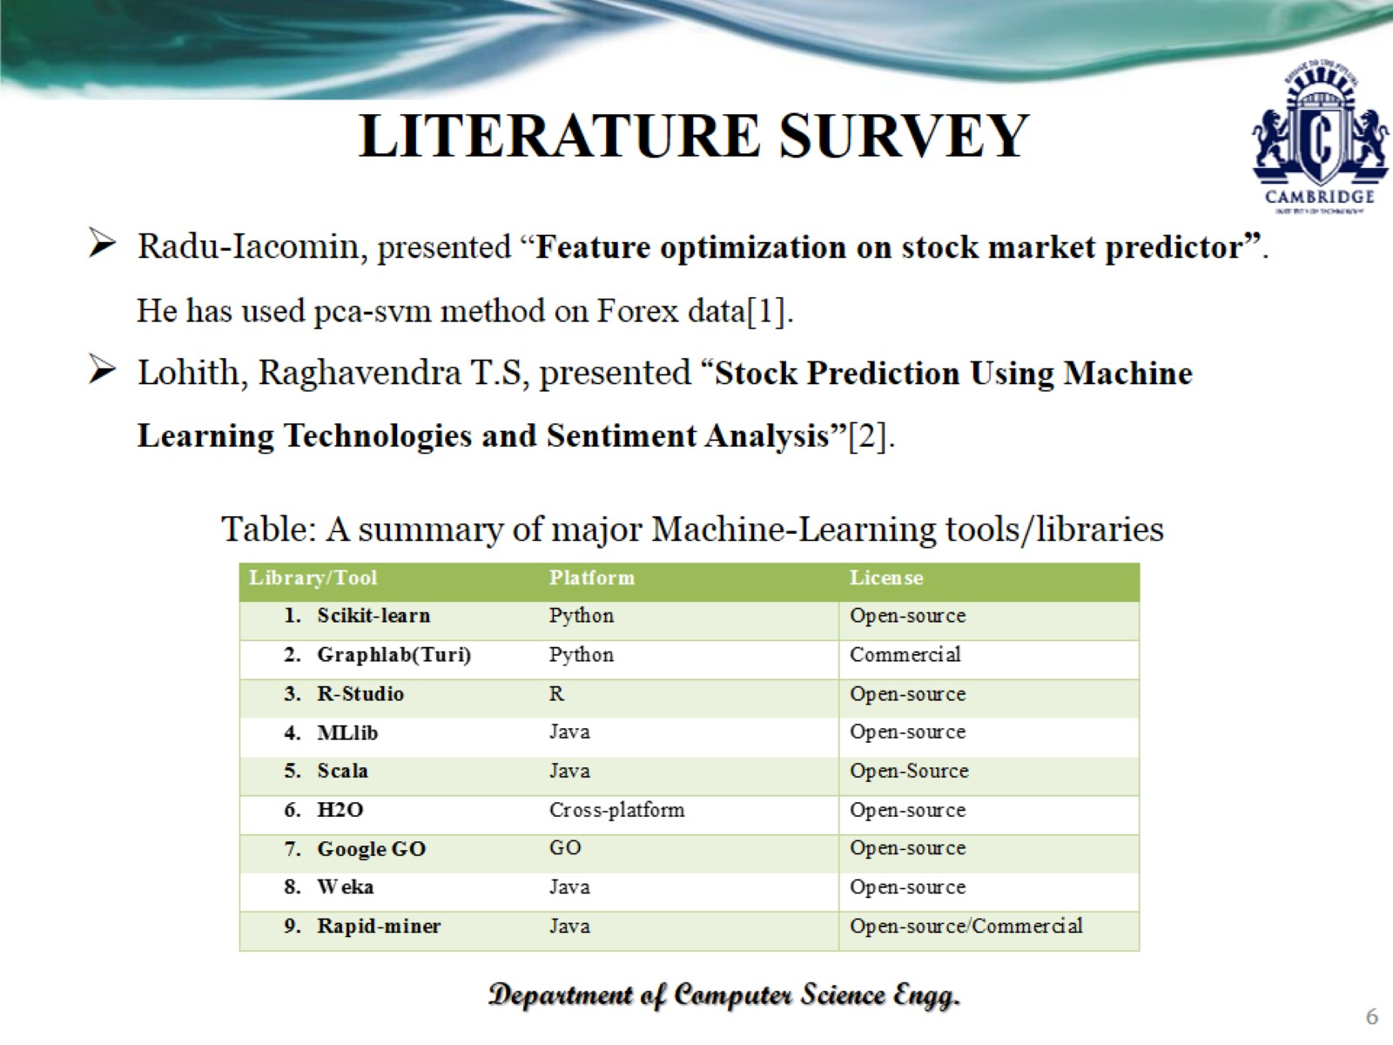
LITERATURE SURVEY

Slide 7
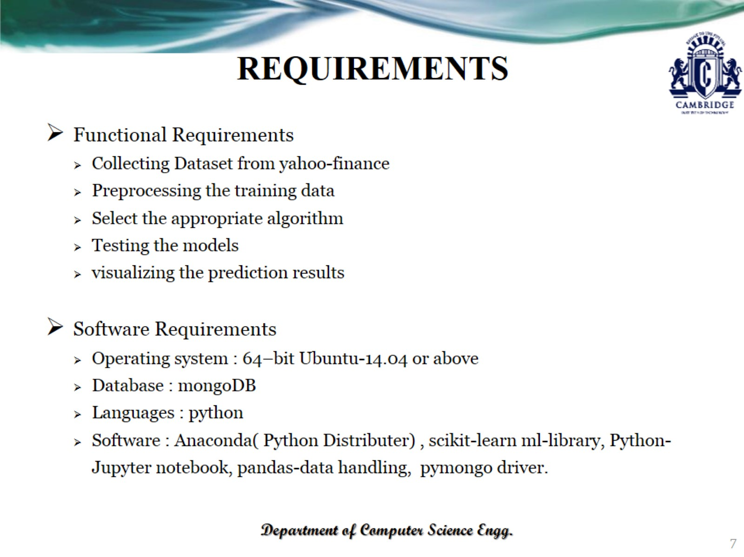
REQUIREMENTS

Slide 8
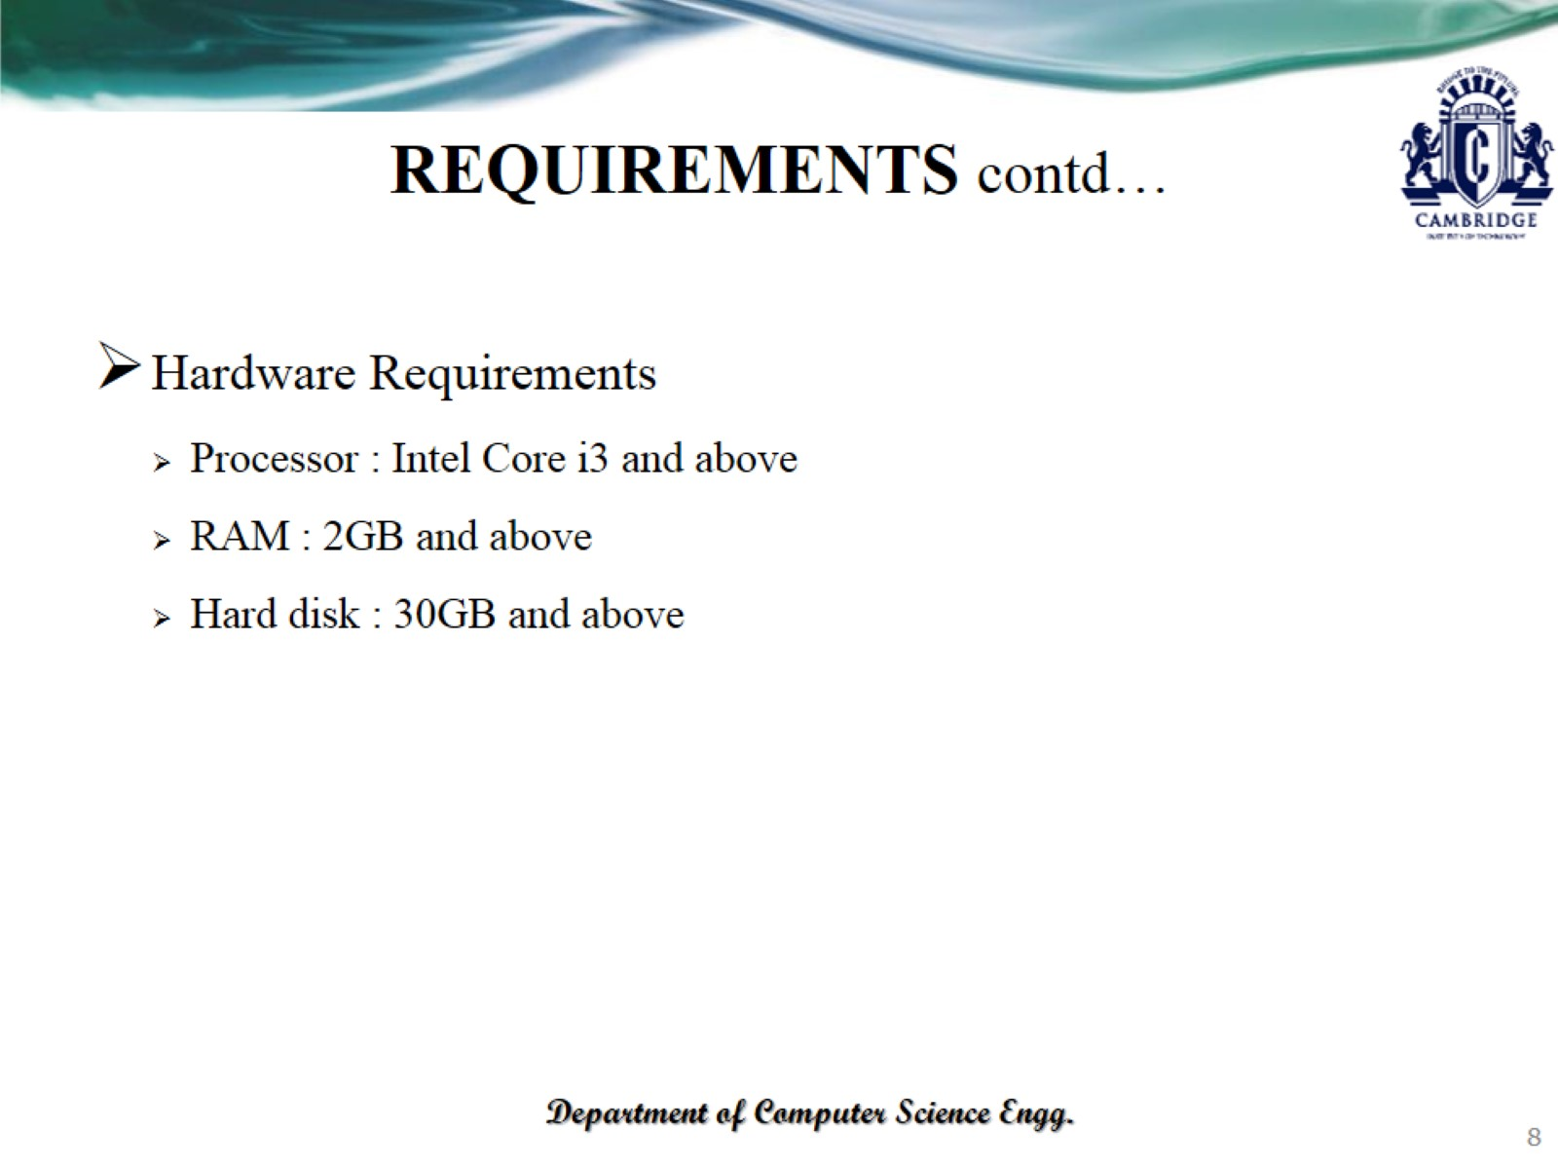
REQUIREMENTS contd…

Slide 9
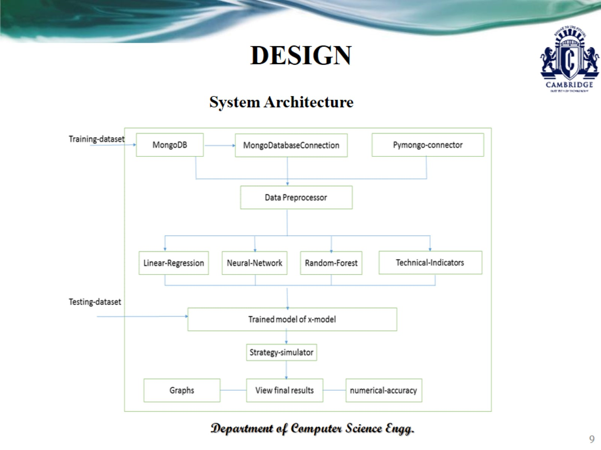
DESIGN

Slide 10
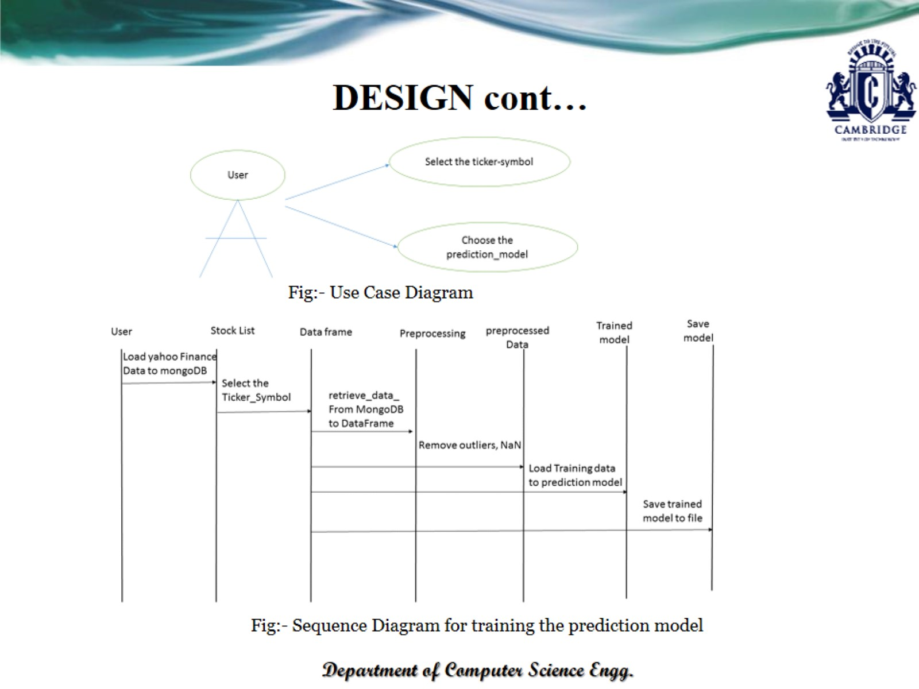
DESIGN cont…

Slide 11
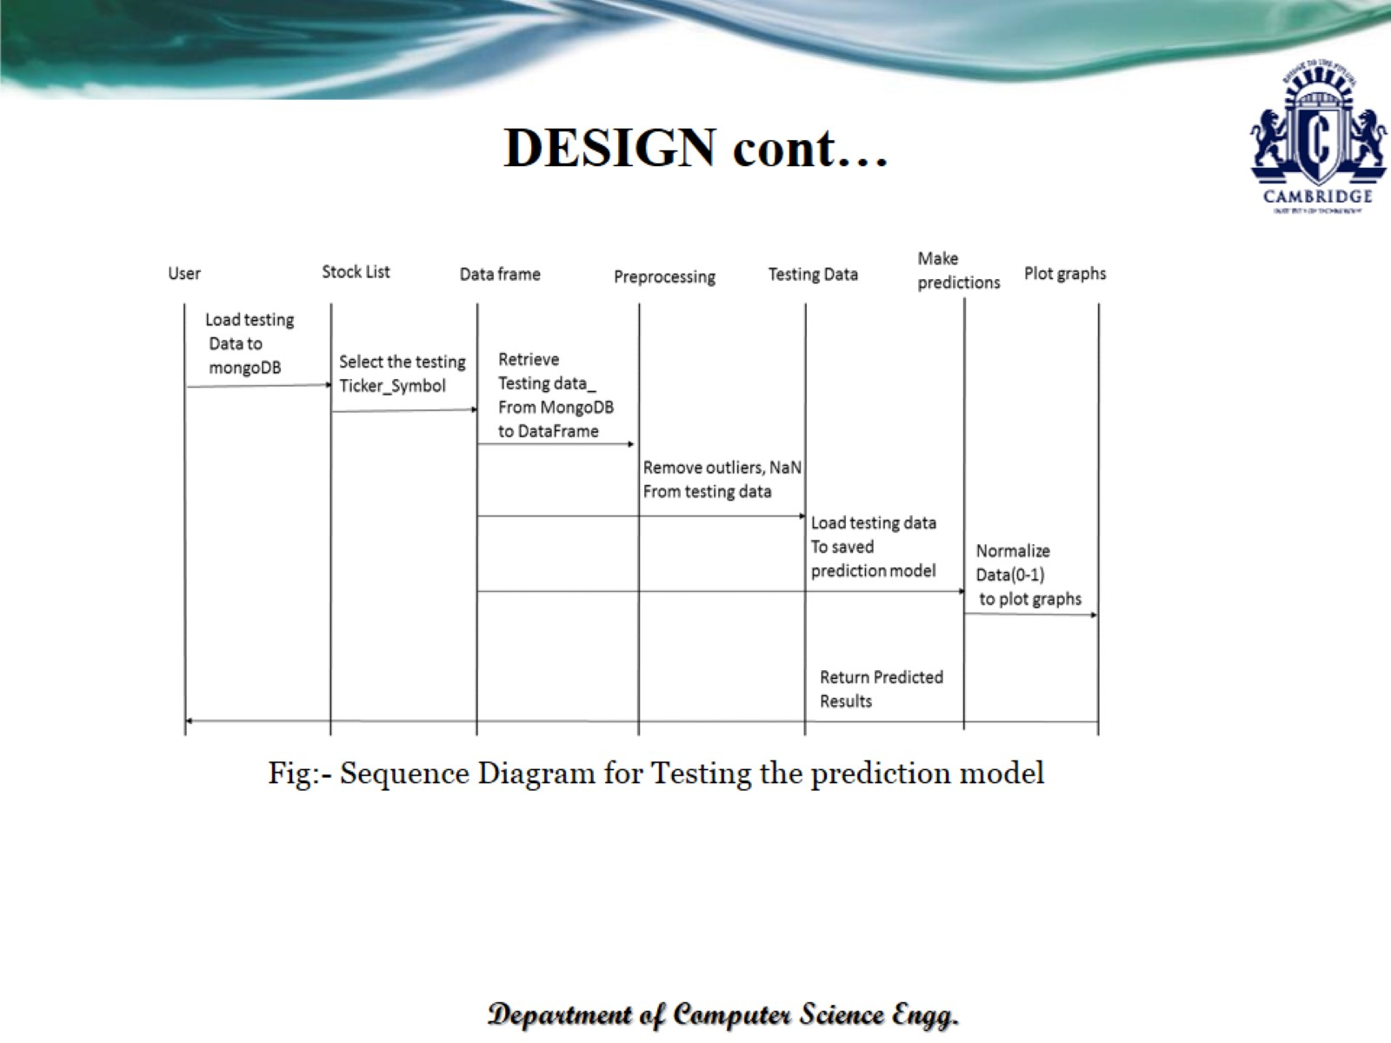
DESIGN cont…

Slide 12
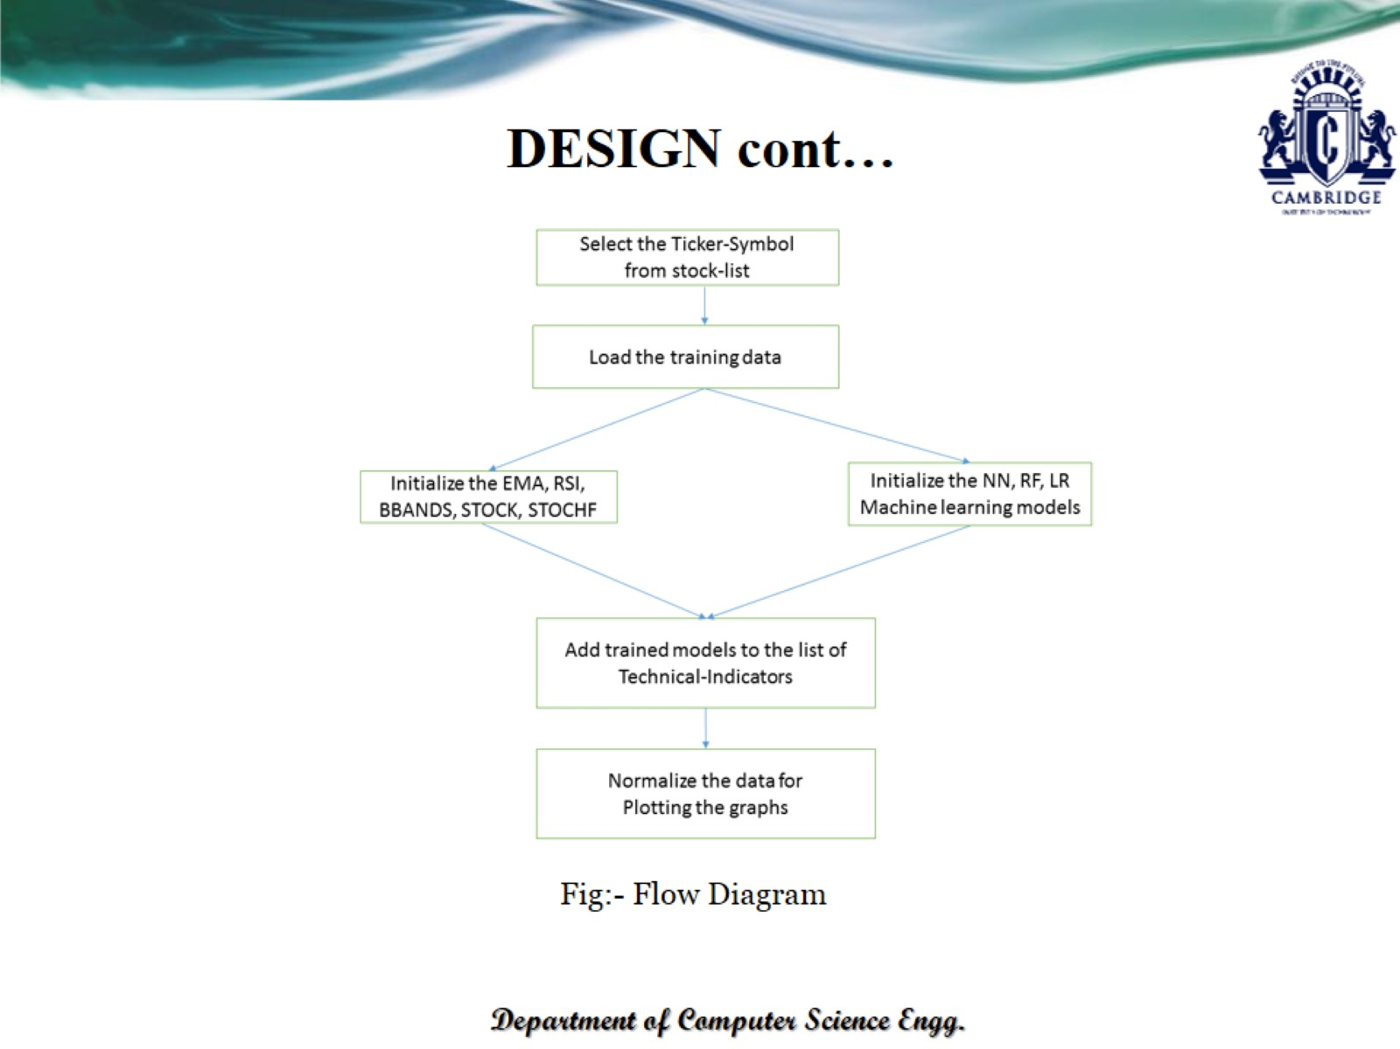
DESIGN cont…

Slide 13
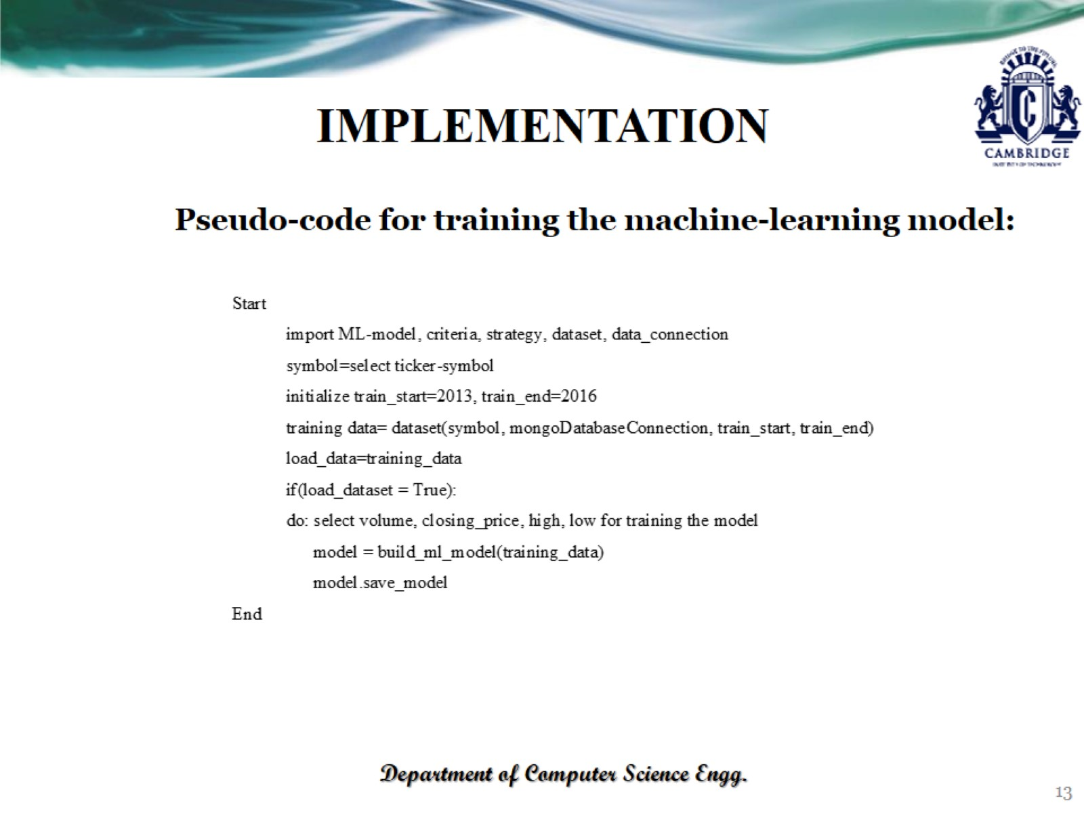
IMPLEMENTATION

Slide 14
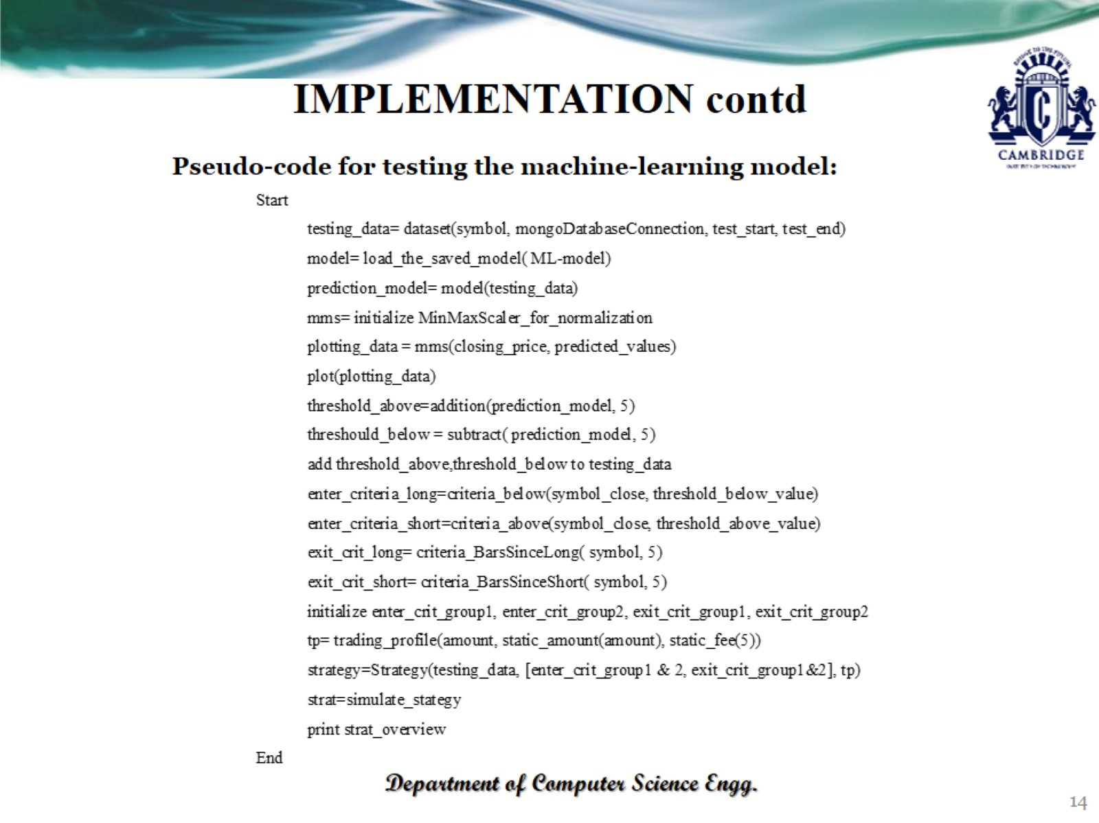
IMPLEMENTATION contd

Slide 15
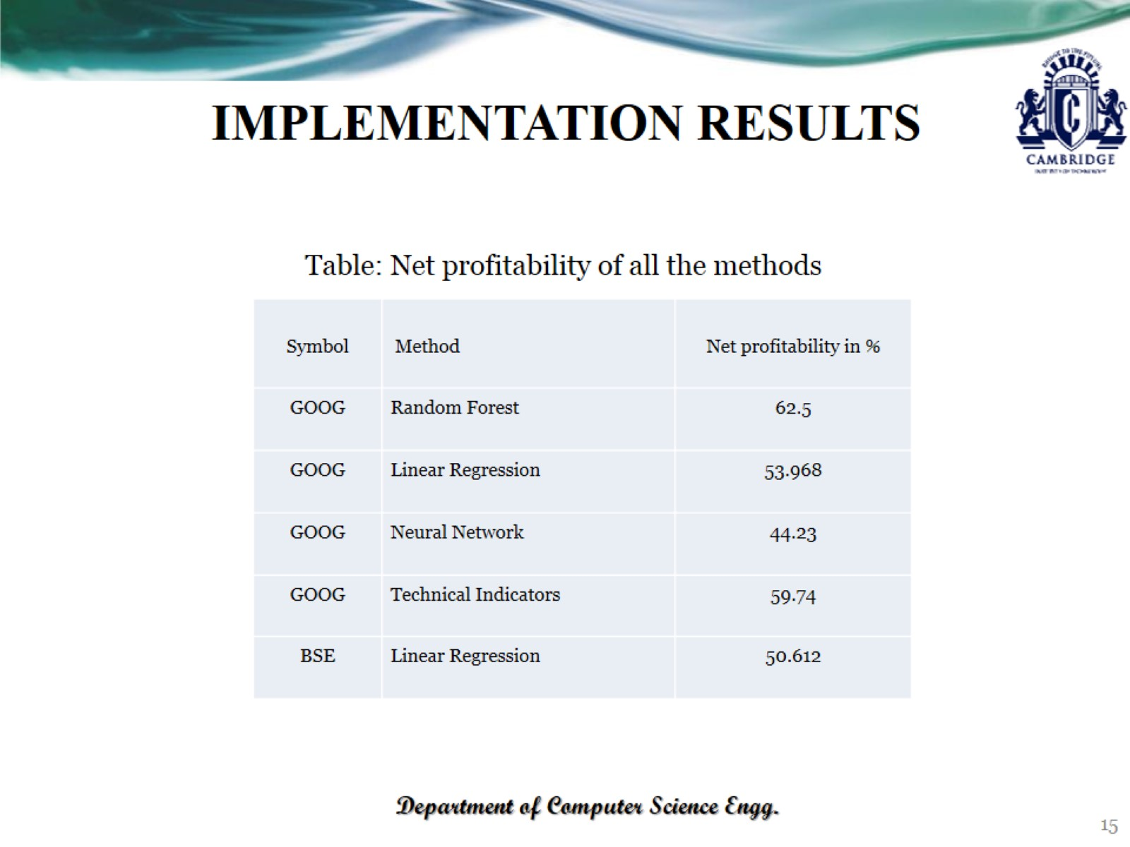

Slide 16
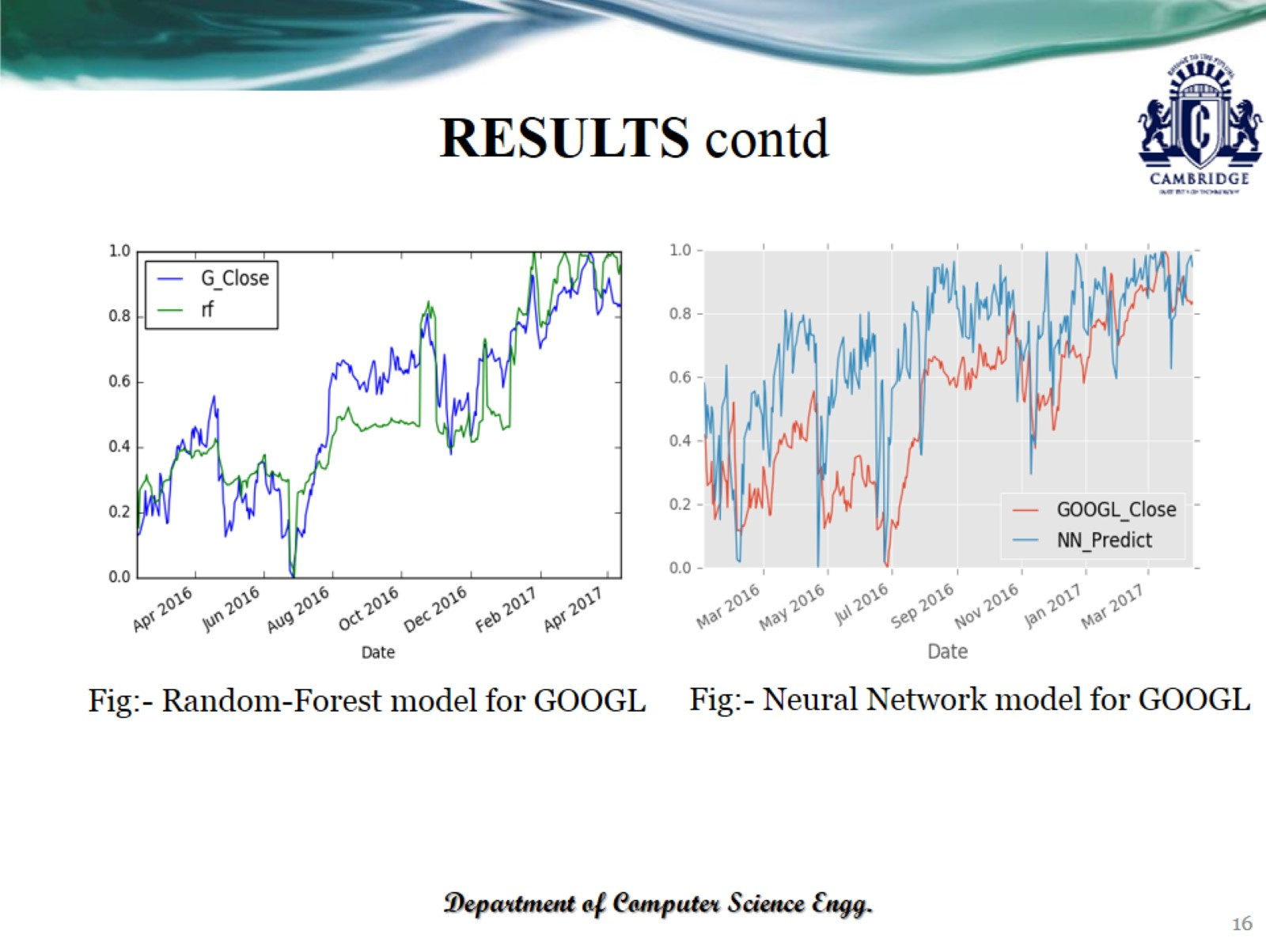
RESULTS contd

Slide 17
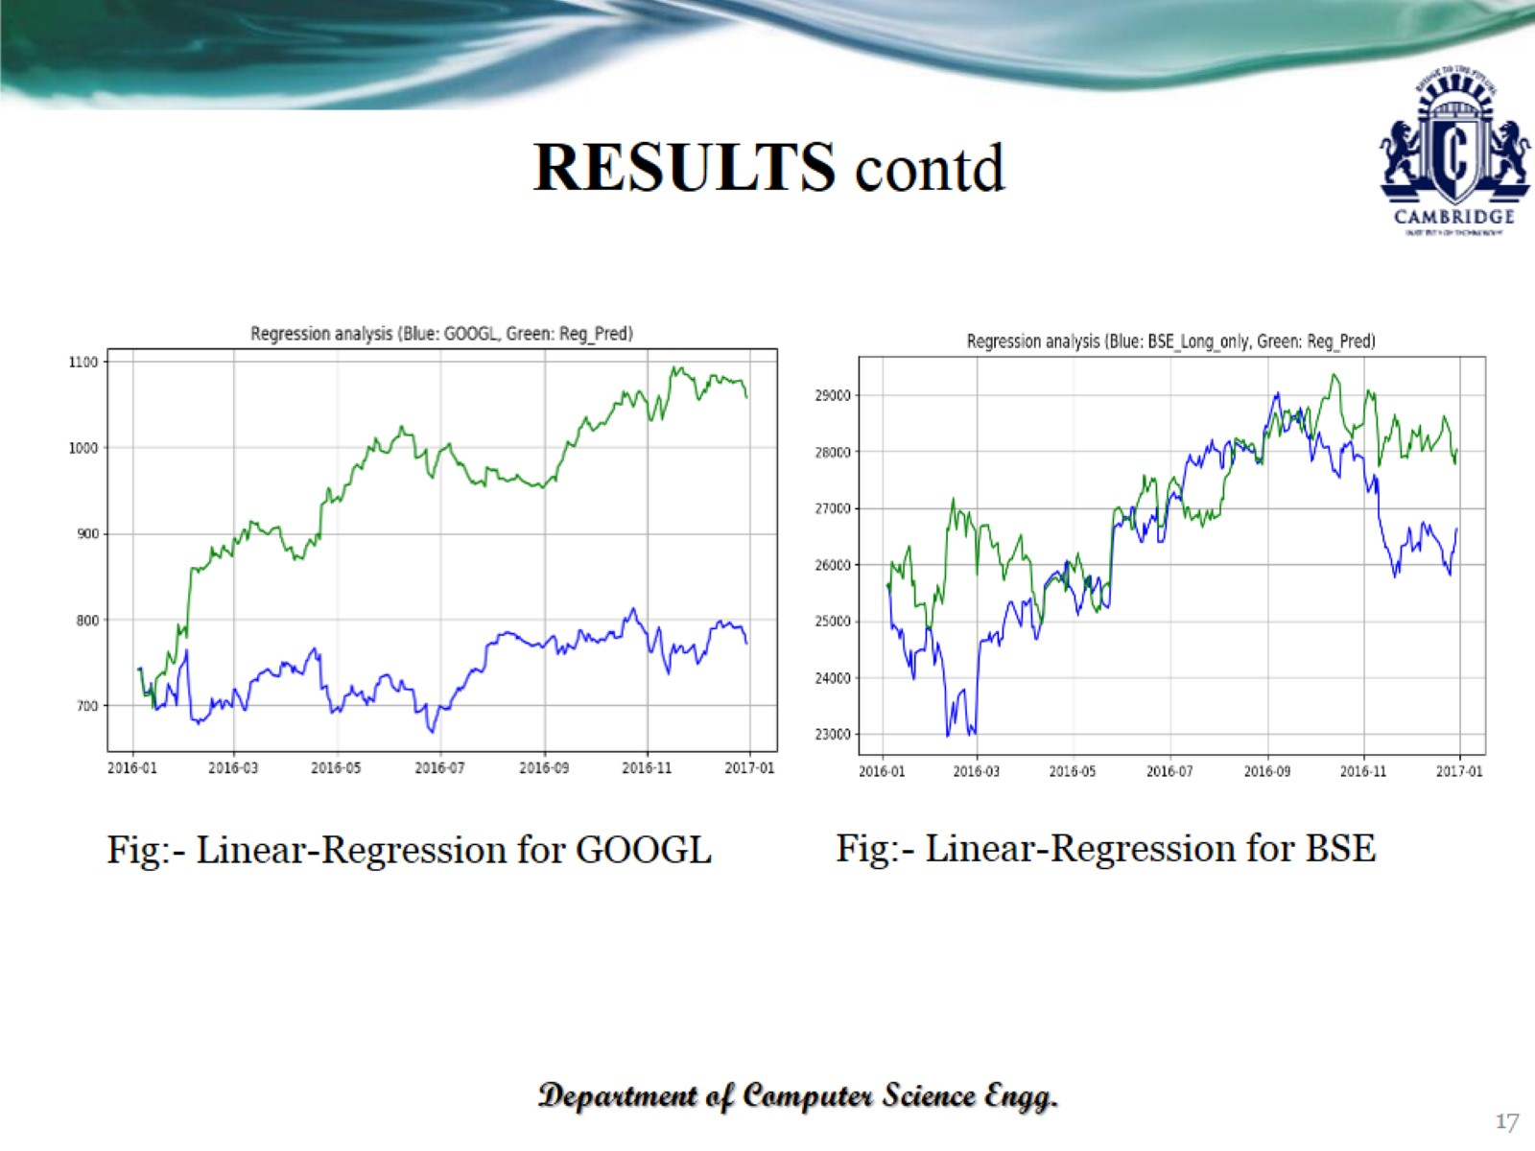
RESULTS contd

Slide 18
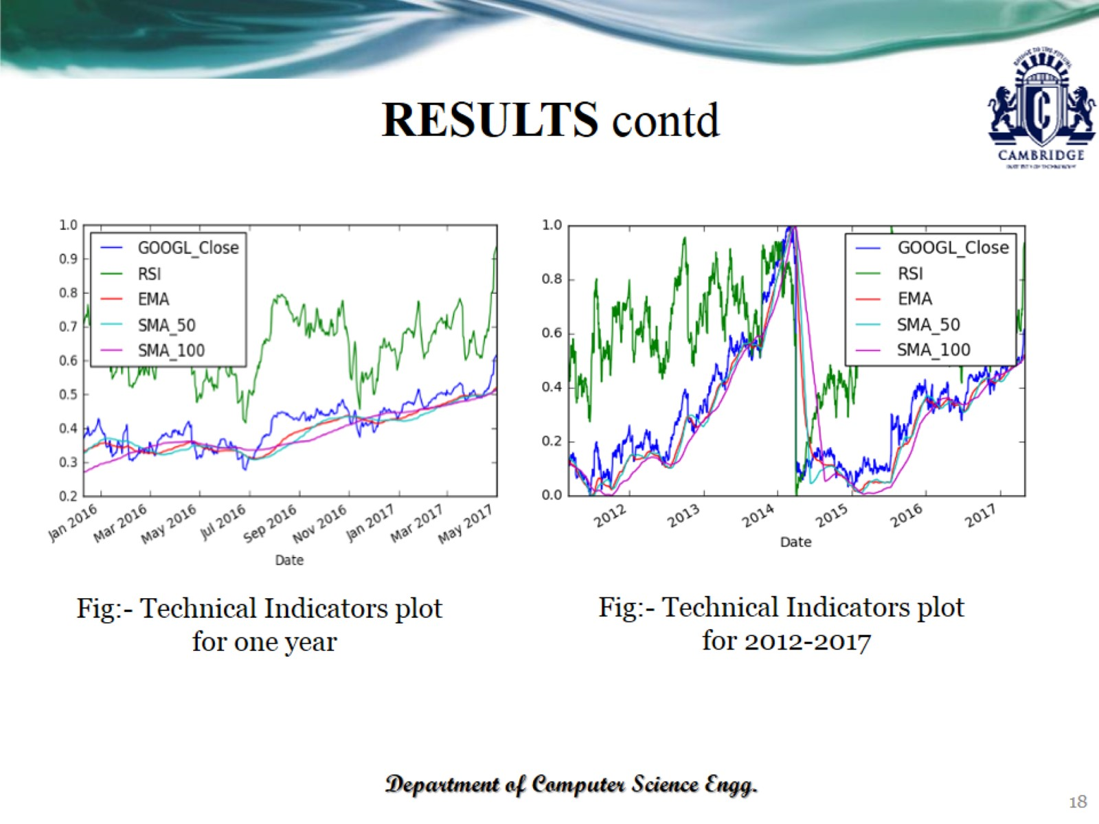
RESULTS contd

Slide 19
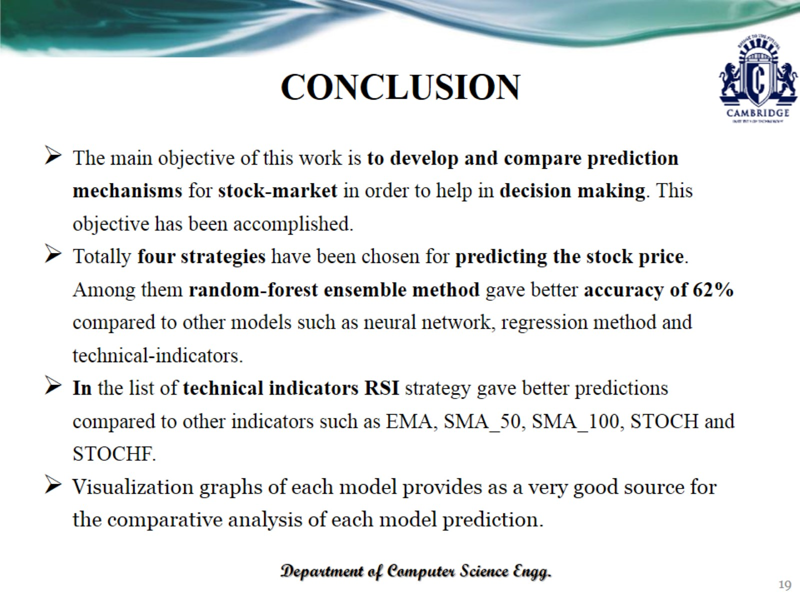
CONCLUSION

Slide 20
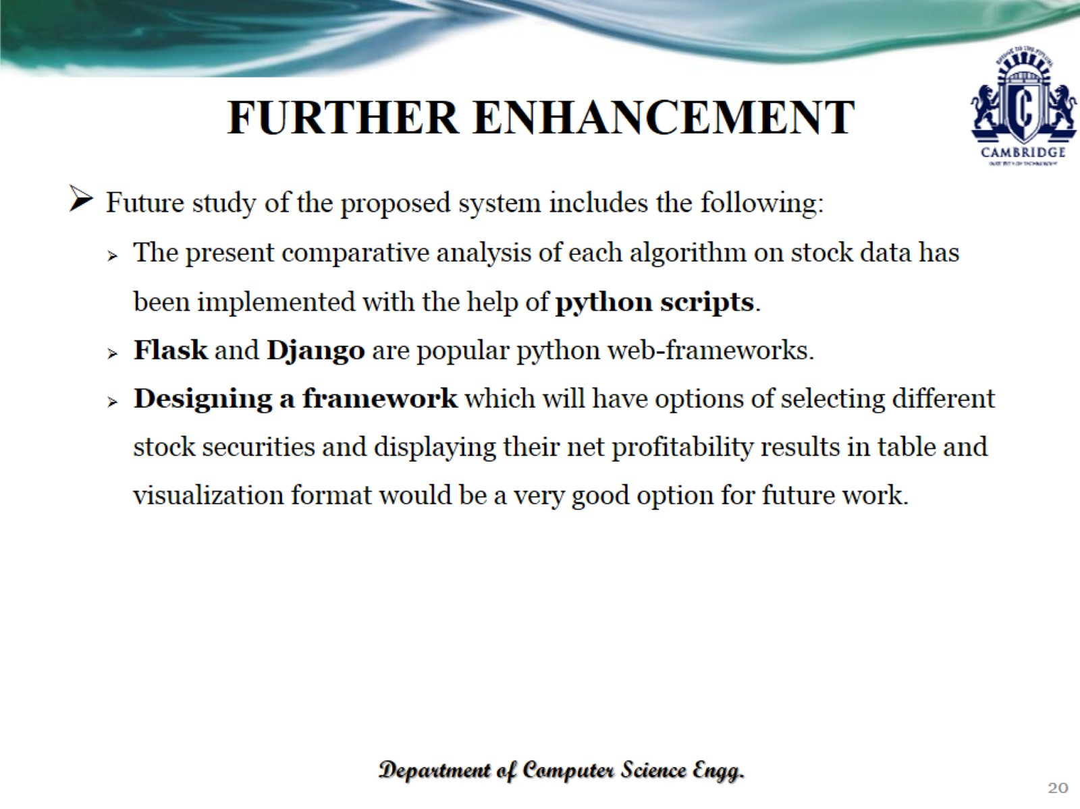
FURTHER ENHANCEMENT

Slide 21

REFERENCES

Slide 22
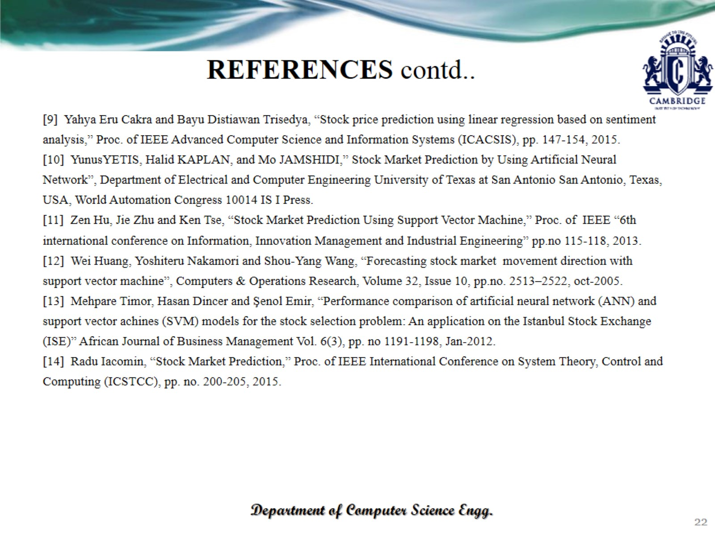
REFERENCES contd..

Slide 23

THANK YOU

